Slide 1
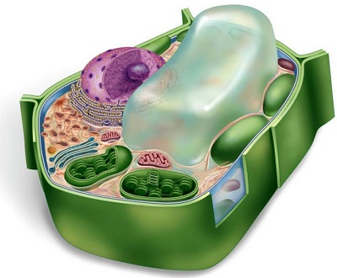
Plastids :
Plastids are double membrane structures present only in plant cells.
They give colour to leaves, flowers and fruits.
Plastids

Slide 2
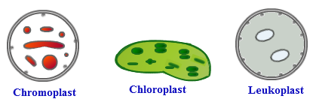
Plastids
are of two types
Coloured
Colourless or white
are called
are called
Chromoplasts
Leucoplasts
Chloroplasts are a type of chromoplasts which are green in colour due to the presence of a green coloured pigment called chlorophyll.

Slide 3

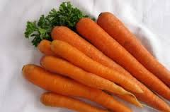
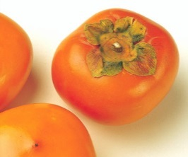
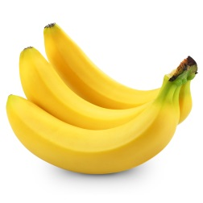
Functions of plastids:
Chloroplasts help to harness solar energy and convert it into chemical energy in the form of food.
Trap
Chromoplasts give colour to flowers and fruits.
Leucoplasts are involved in the synthesis and storage of various kinds of food like starch, oils and proteins.
Production

Slide 4
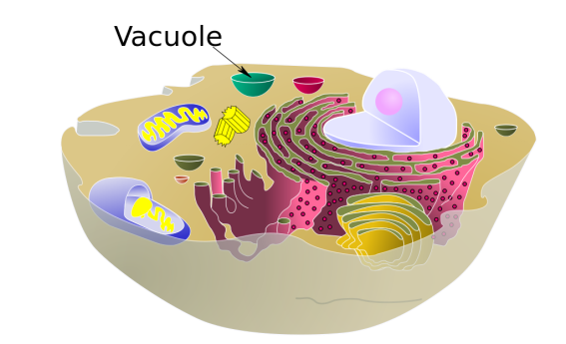
Vacuoles :
Vacuoles are storage sacs for solid or liquid contents.
Vacuole is bound by a single membrane.
They do not have any basic shape or size.
i.e. one layered
The structure of the vacuole changes according to the need of the cell.
Animal cells have few small sized and temporary vacuoles.
While plant cells have one or more large vacuole.
Vacuole

Slide 5
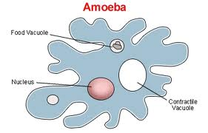
Functions of vacuoles :
Vacuoles help to maintain osmotic pressure of the cell.
They store metabolic byproducts and end products. E.g. Glycogen, proteins and water.
Balance of water
Products of various chemical reactions
They store waste products and food in animal cell. E.g. in amoeba it stores food so it is called as food vacuole.
Firmness
In plant cells vacuoles are full of cell sap and provide turgidity and rigidity to them.
Mixture of water and minerals
Stiffness
G
Cell sap
W
P
P
W
G

